Slide 1
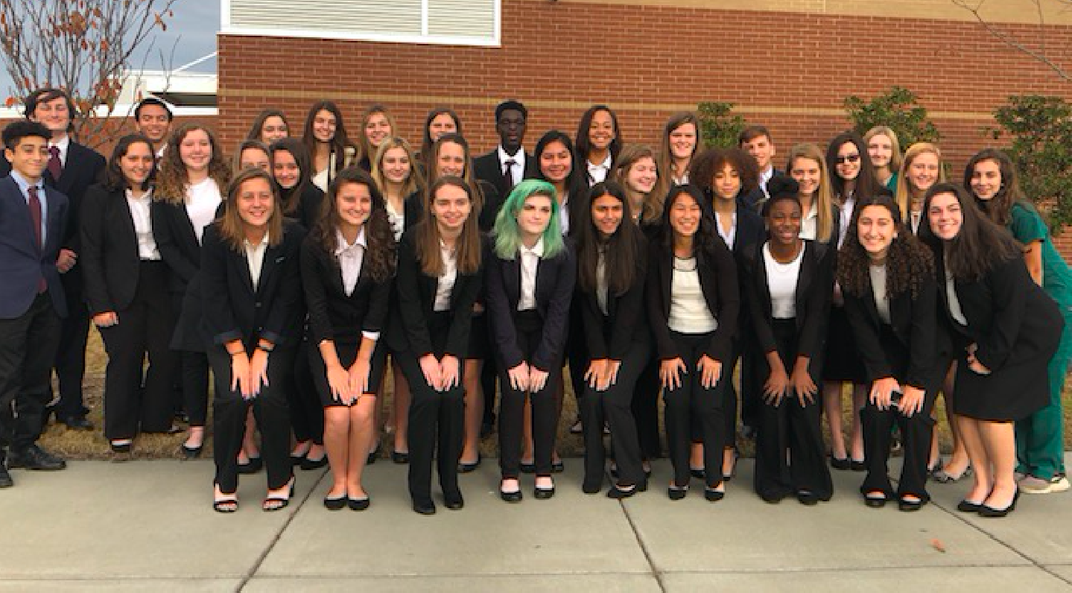
Welcome
New HOSA 2020-2021 Officers
Leadership influences the minds, hearts, and actions of others.
“A great leader’s courage to fulfill his vision come from passion, not position.” - John C. Maxwell
“ True leaders understand that leadership is not about them but about those they serve. It is not about exalting themselves but about lifting other up.” - Sheri L. Dew

Slide 2
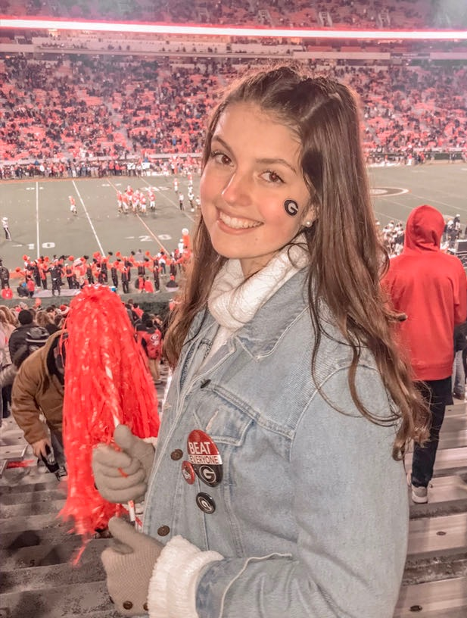
Co- Presidents
Gretchen Davis
Brooke Ertl

Slide 3
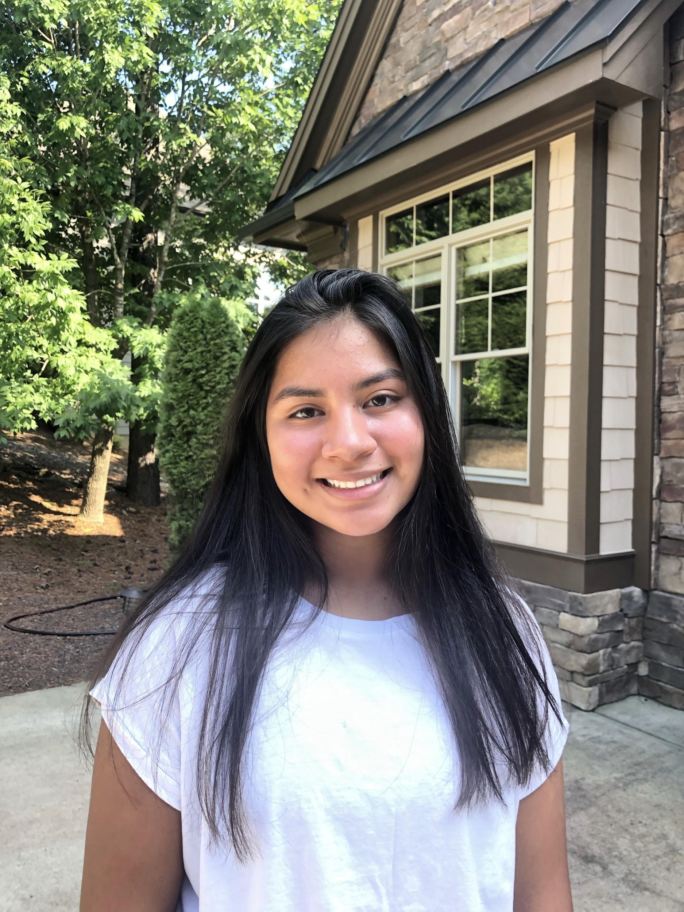
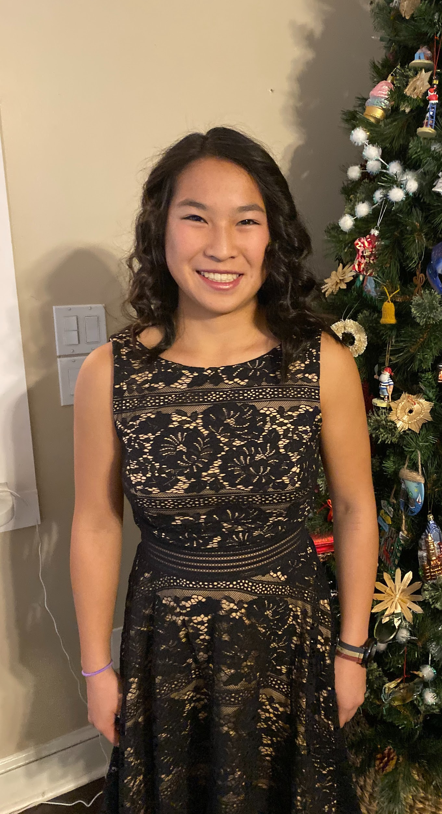
Co-Vice Presidents
Gabby Collazos
Olivia Riggsbee

Slide 4
SECRETARY
Ayanna Blake
Interview video: https://drive.google.com/file/d/140eSR37hqfsWG5T__OMItx_DEcuowNa-/view
Lauryn Womble
Interview video:
https://drive.google.com/file/d/1ueFVQYSNNVsdp2b_hSdOKkHY-1umQ509/view

Slide 5
TREASURER
Preston Hinson

Slide 6
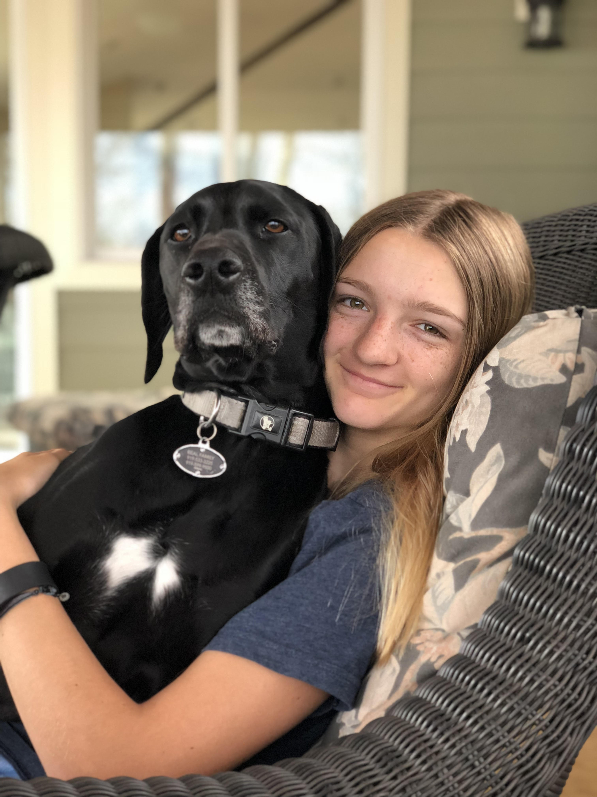
Reporter
Brooke Beal

Slide 7
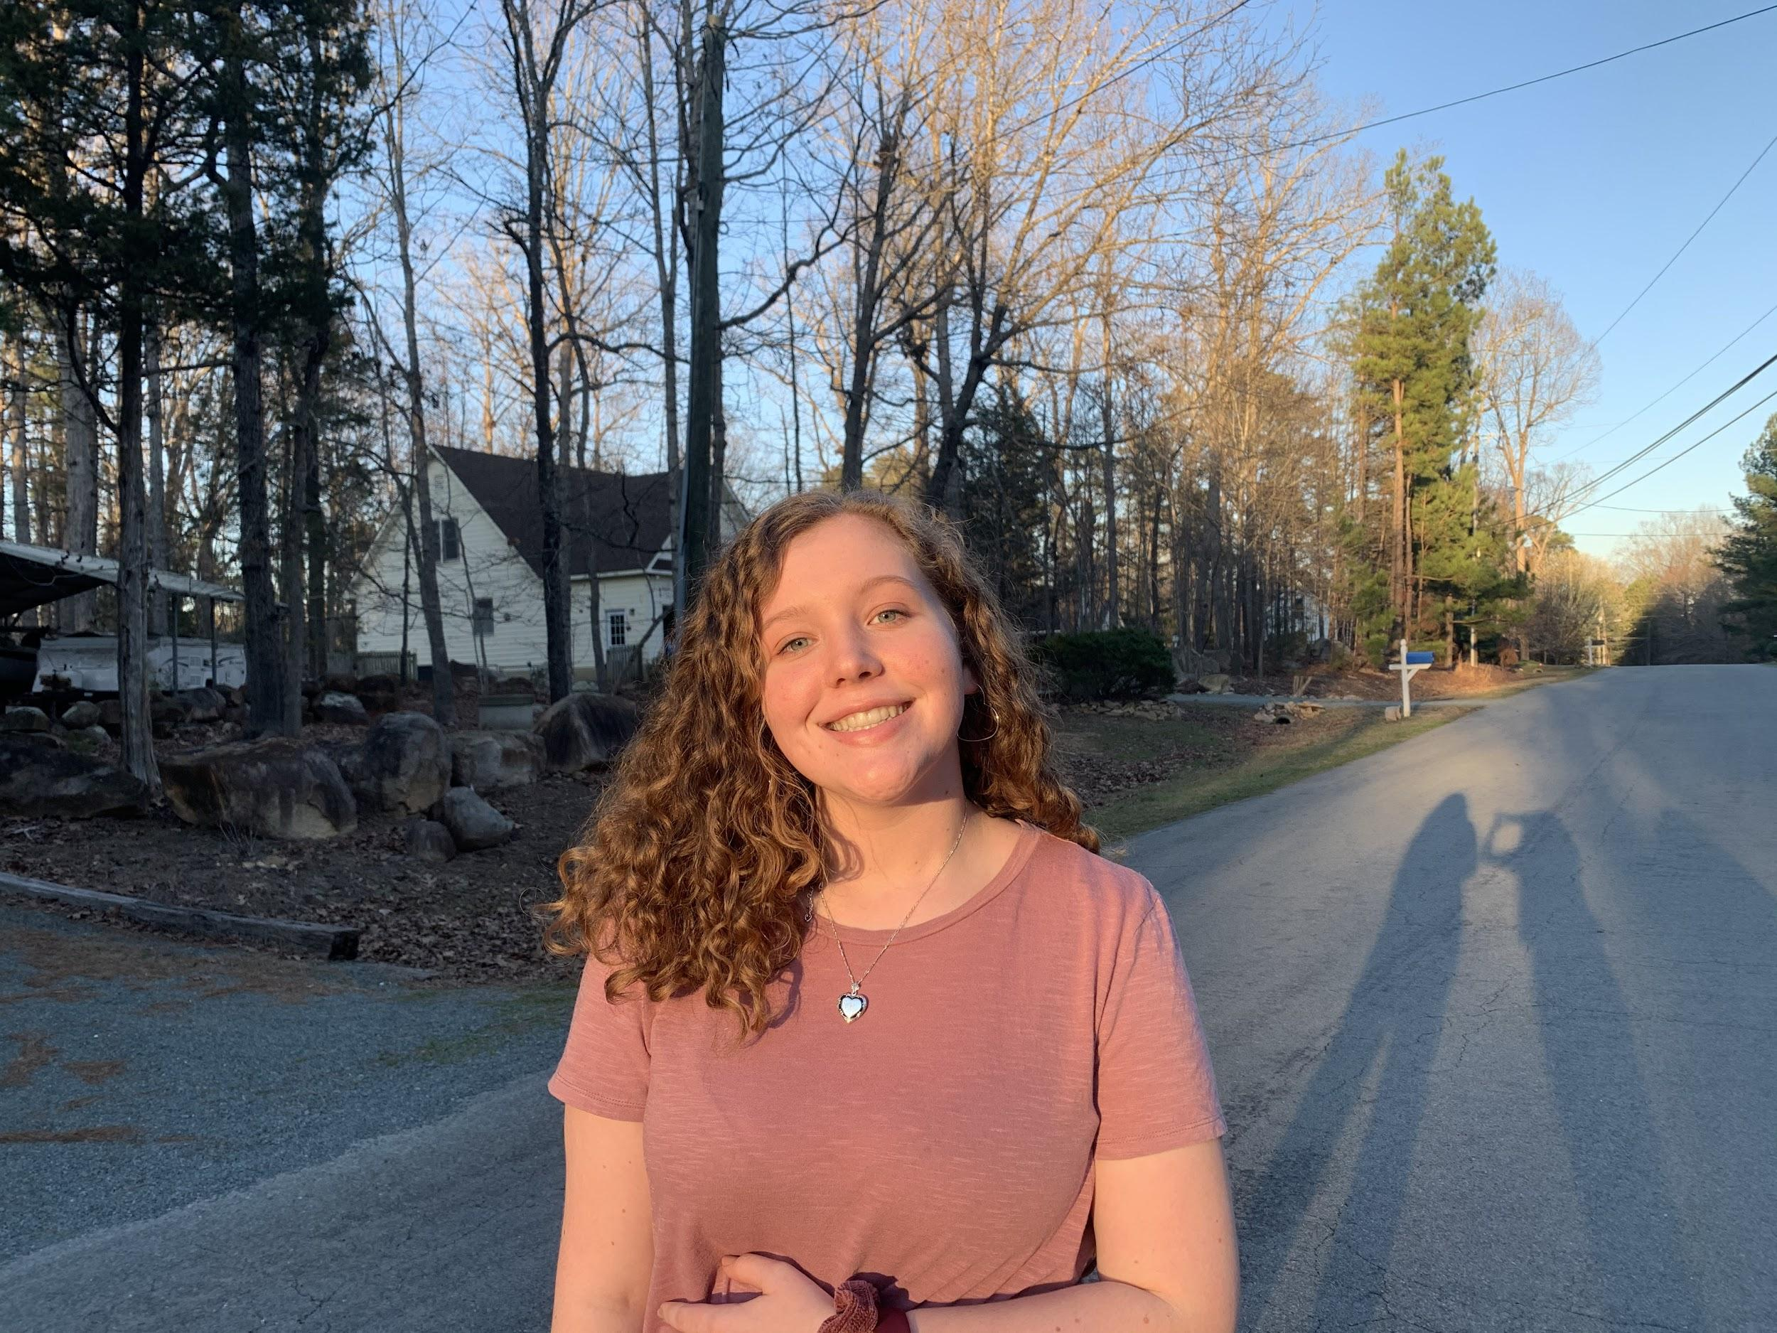
Historian
Lily Fowler
Katherine Reyes

Slide 8
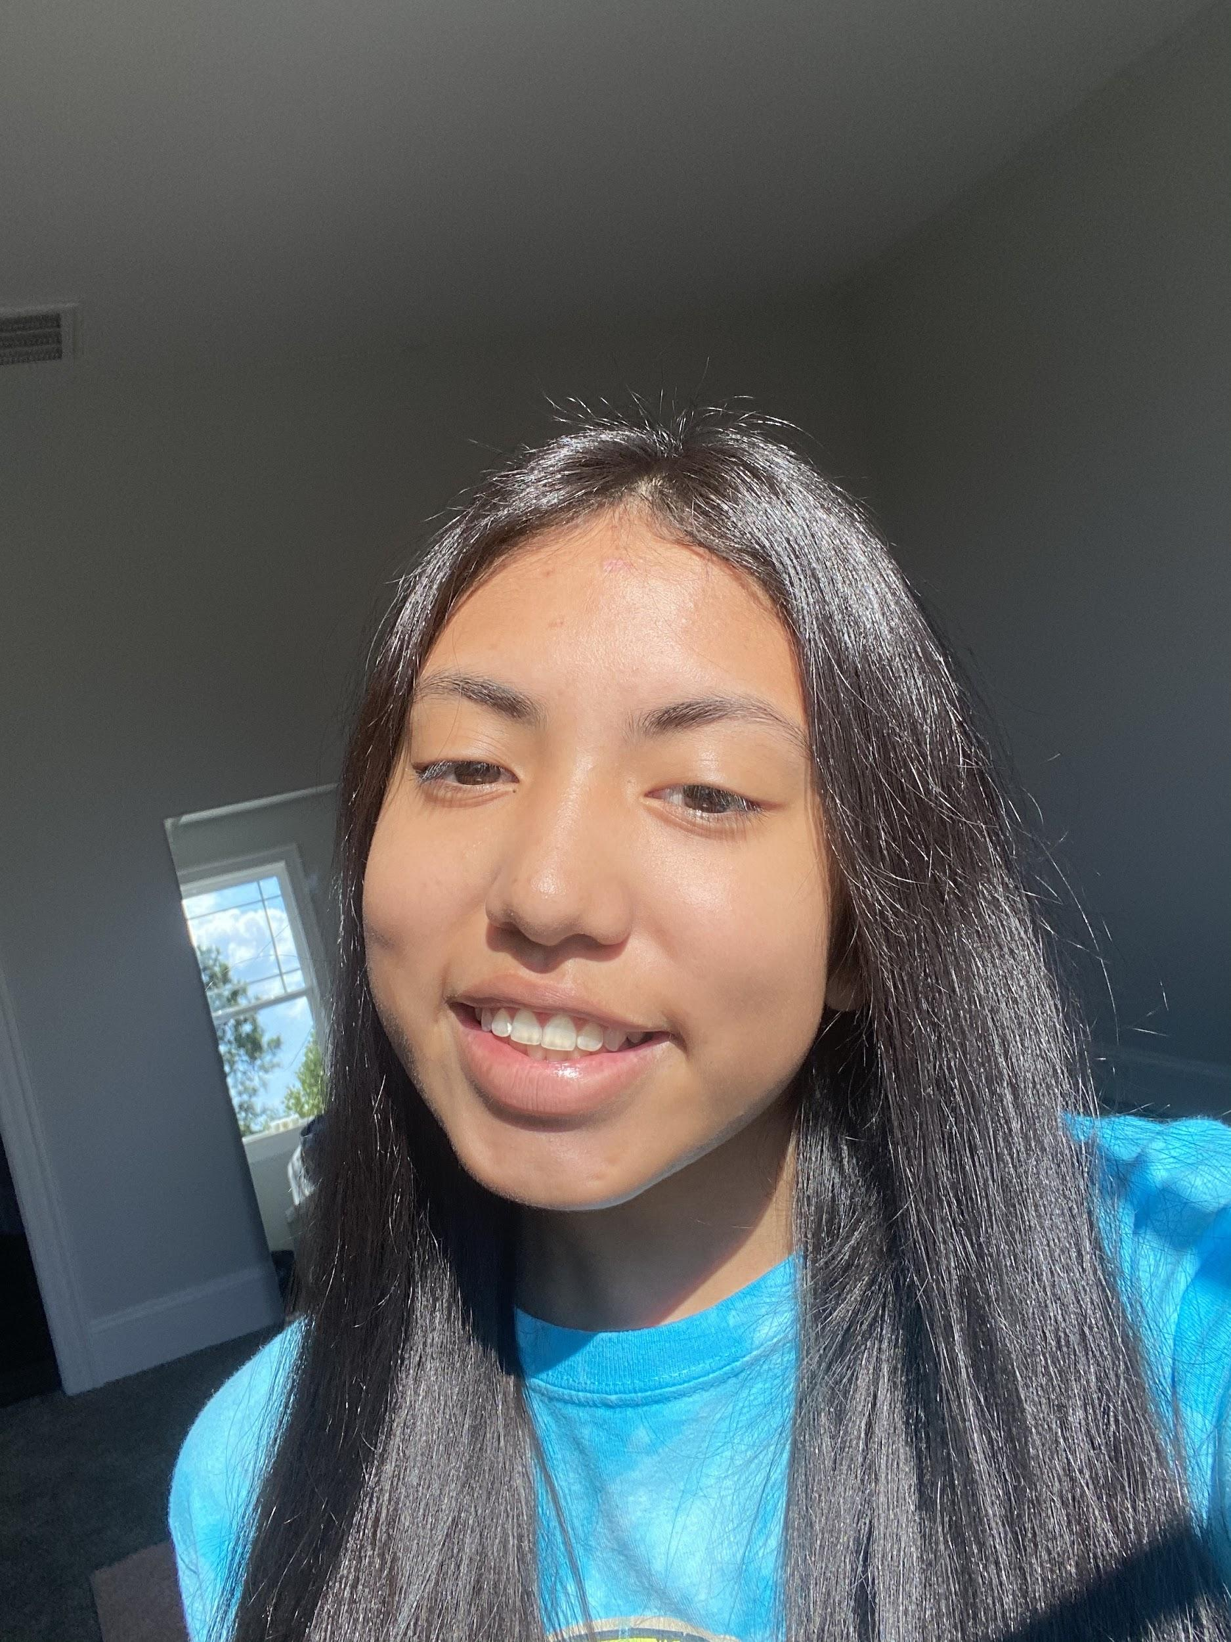
Parliamentarian
Bella Cacciato
Aracely Aucestovar

Slide 9
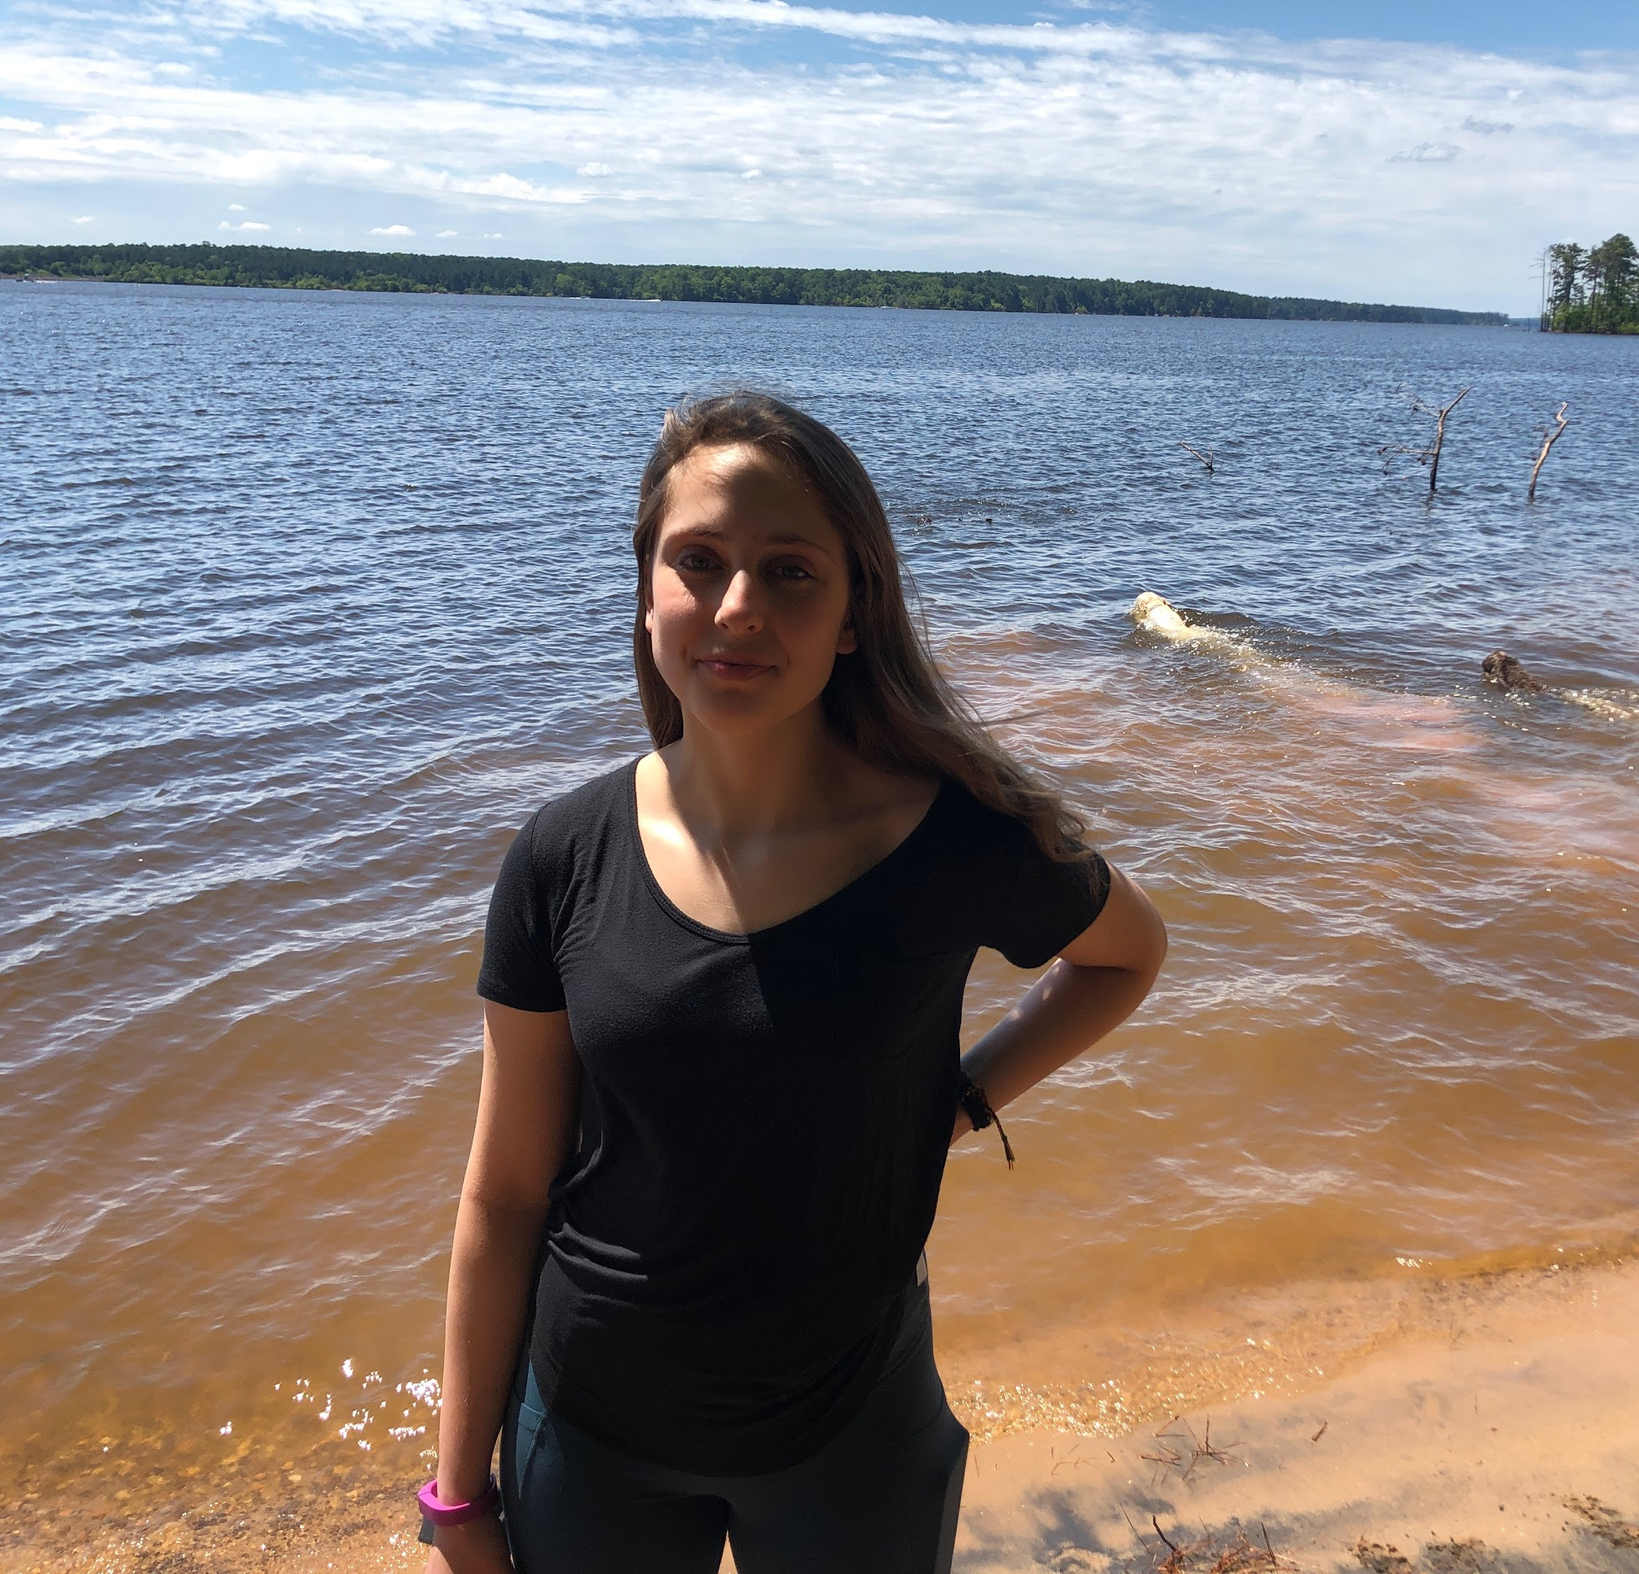
Photographers
Catie Harrigan
Mason Cook

Slide 10
Competition Coordinator
Simar Kaur (Brooke E. to work with her)

Slide 11
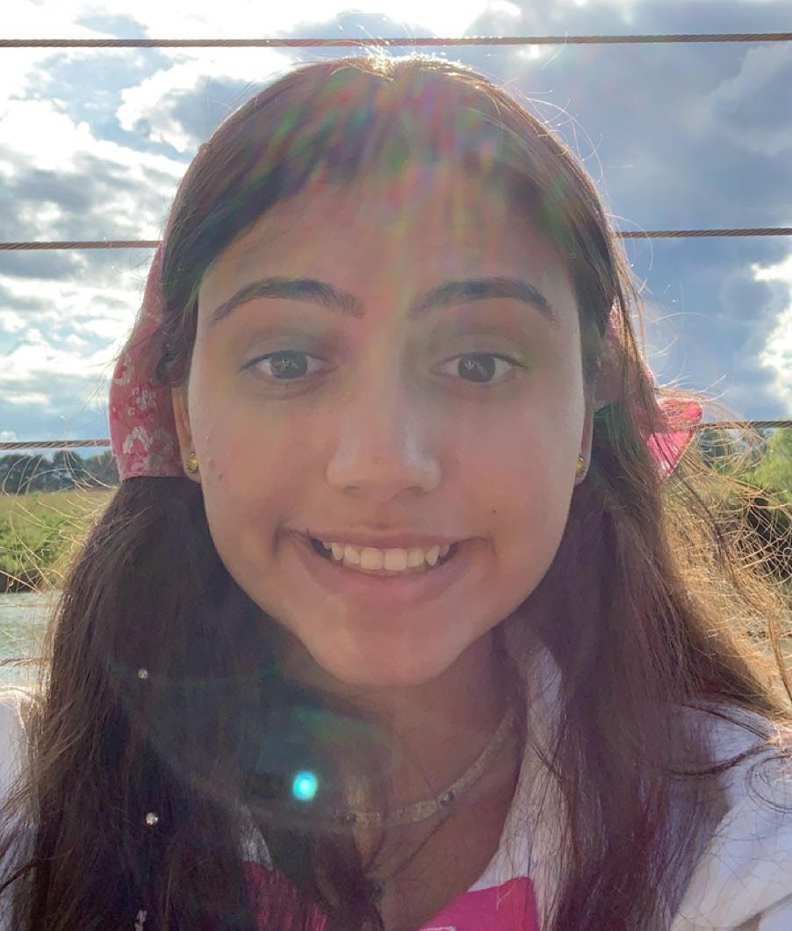
Community Service Coordinator
Aza McFadden
(Assistant Lillian House)
Interview Link: https://drive.google.com/file/d/1W3qmEEM6PsBJnHUgfsz7uNJKKfw1Gygu/view?usp=sharing

Slide 12
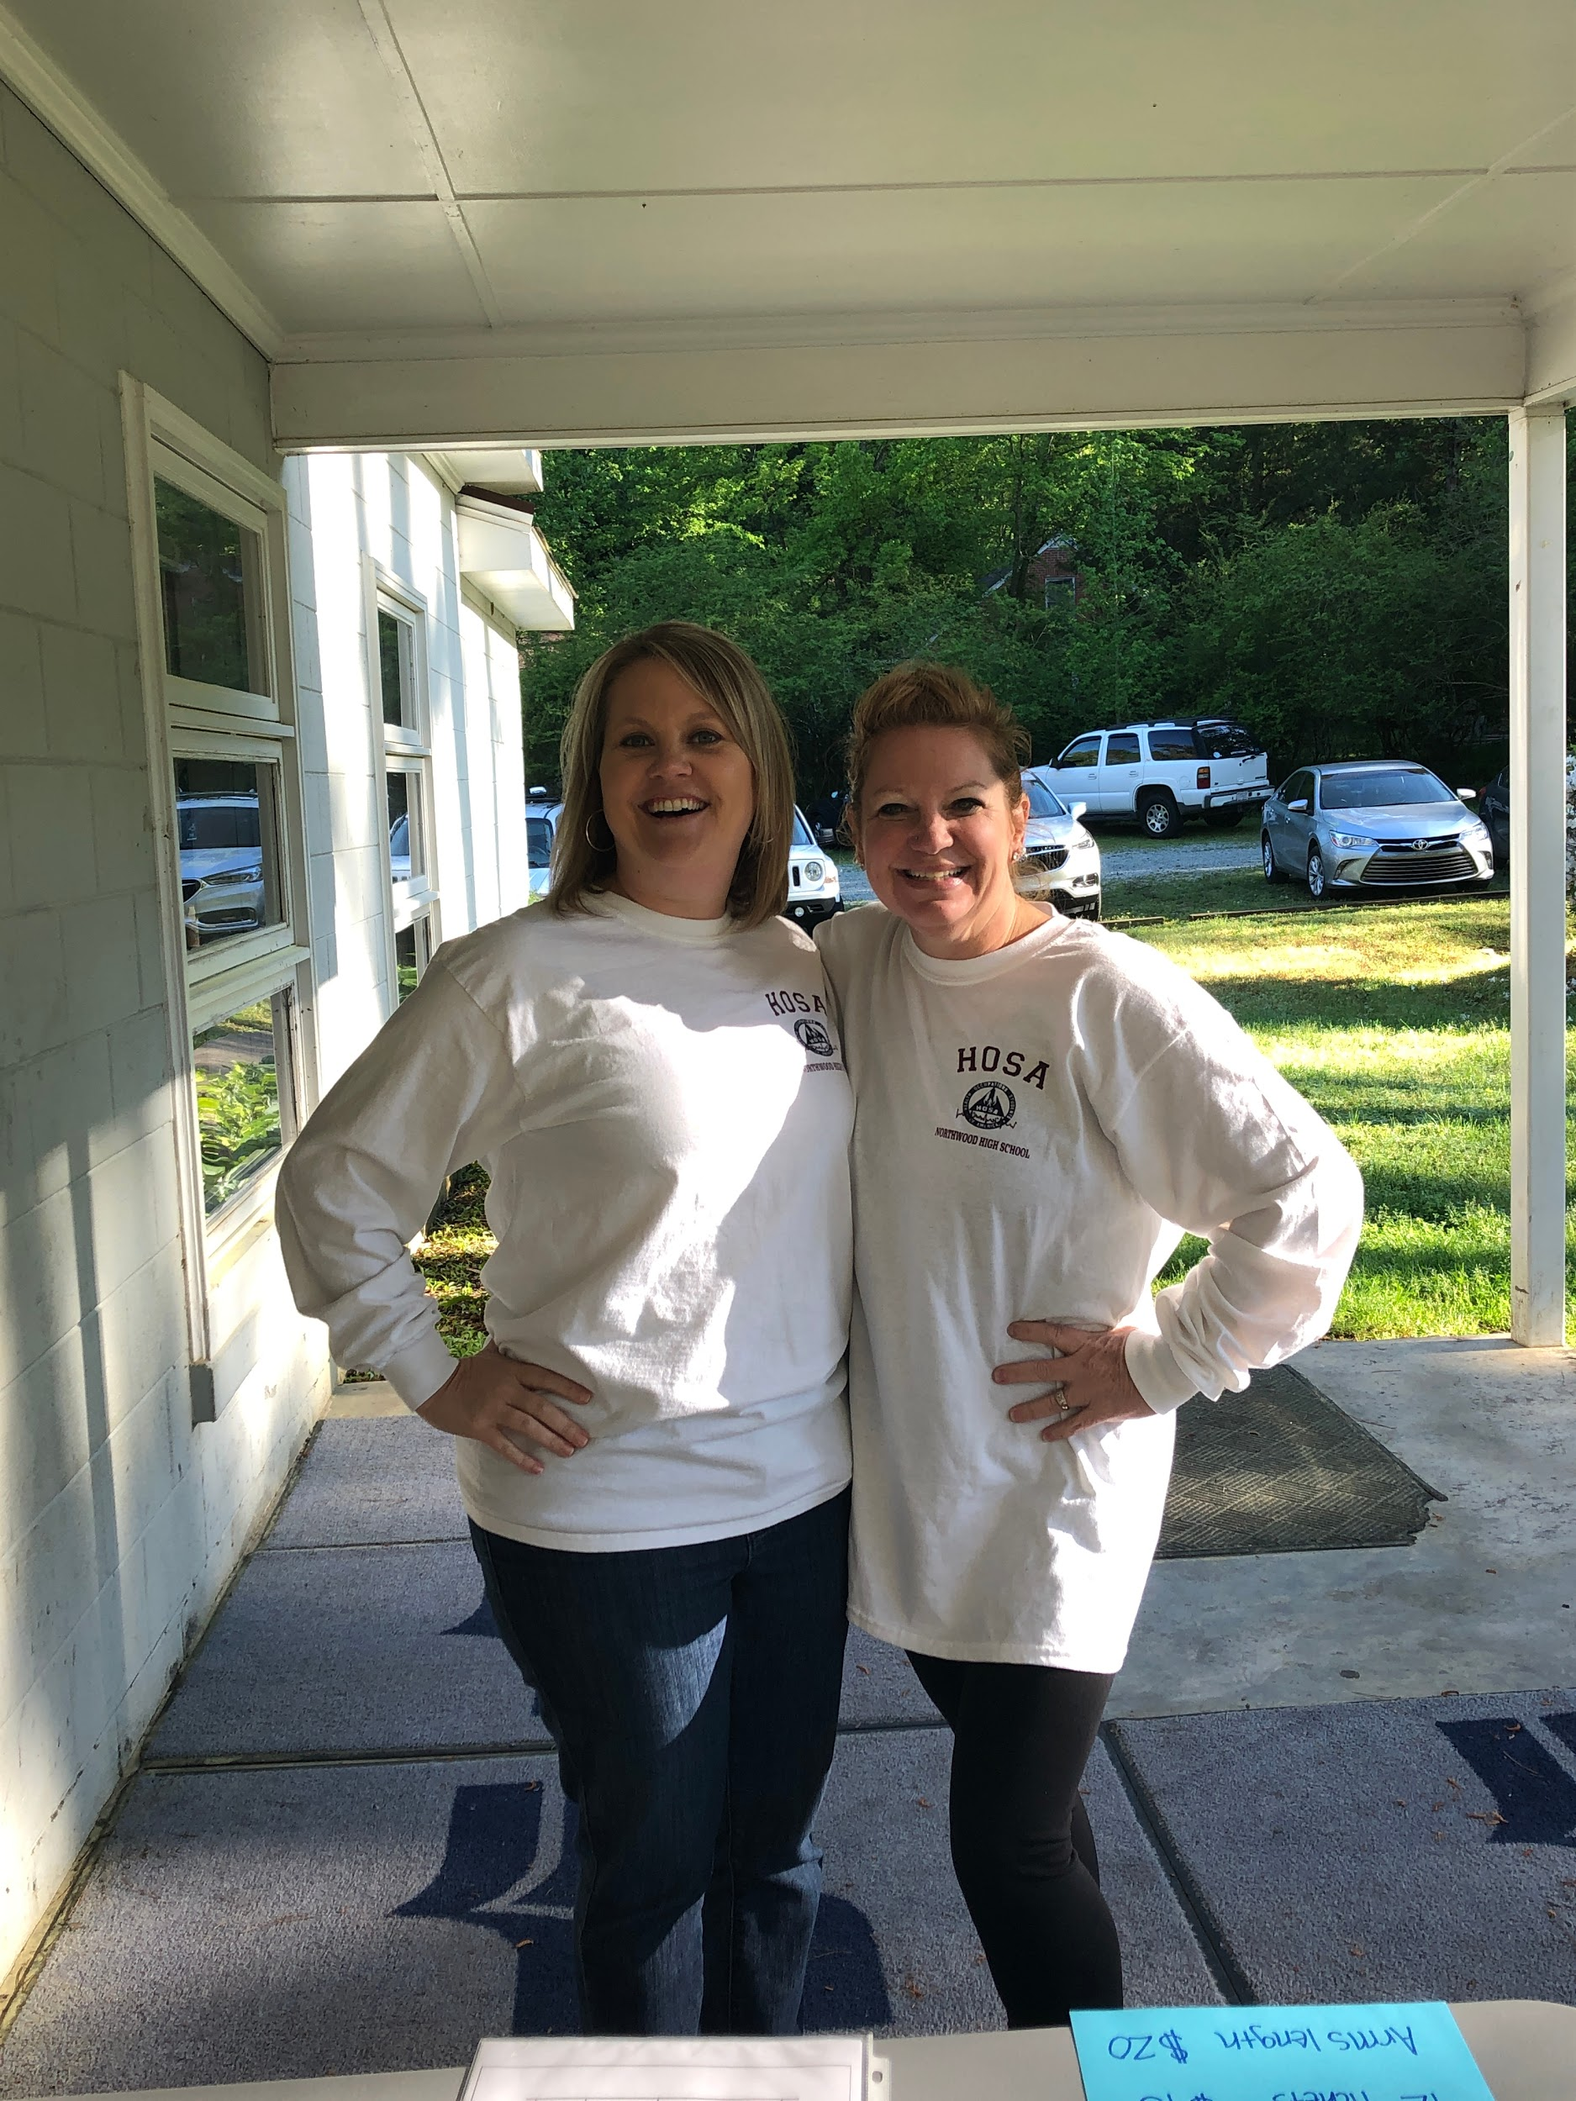
HOSA Advisors
Mrs. Sherri Stubbs
Mrs. Julie Fogle

Slide 13
HOSA Mission & Purpose
Mission
The mission of HOSA is to empower HOSA-Future Health Professionals to become leaders in the global health community through education, collaboration, and experience.
Purpose
The purpose of HOSA-Future Health Professionals is to develop leadership and technical HOSA skill competencies through a program of motivation, awareness and recognition, which is an integral part of the Health Science Education instructional program.

Slide 14
HOSA
I recognize the universal need for quality, compassionate healthcare.
I understand the importance of academic excellence, skills training, and leadership development in my career pathway.
I believe through service to my community and to the world, I will make the best use of my knowledge and talents.
I accept the responsibility of a health professional and seek to find my place on a team equally committed to the well-being of others.
Therefore, I will dedicate myself to promoting health and advancing healthcare as a student, a leader, an educator, and a member of HOSA-Future Health Professionals.
CREED

Slide 15
HOSA CORE
Core Values
We value learning. We are committed to learning and becoming respected, knowledgeable and skilled health professionals. We will respect the experiences and contributions of our teachers, peers and patients and seek to learn from them.
We value leadership. We will serve as role models in our academic program, profession and community. We will be ethical, accountable and trustworthy. We will use our influence to empower others to strive for excellence.
We value service. We are dedicated to serving others with compassion. We believe that individuals are important, and we will treat everyone with respect and care.
We value innovation. We are dedicated to enriching the lives of others. We will continuously seek the knowledge and skills to address challenges and improve the health professions.
VALUES

Slide 16
HOSA Goals
The goals that HOSA believes are vital to each member are:
To promote physical, mental and social well being.
To develop effective leadership qualities and skills.
To develop the ability to communicate more effectively with people.
To develop character.
To develop responsible citizenship traits.
To understand the importance of pleasing oneself as well as being of service to others.
To build self-confidence and pride in one's work.
To make realistic career choices and seek successful employment in the healthcare field.
To develop an understanding of the importance in interacting and cooperating with other students and organizations.
To encourage individual and group achievement.
To develop an understanding of current healthcare issues, environmental concerns, and survival needs of the community, the nation and the world.
To encourage involvement in local, state and national health care and education projects.
To support Health Science Education instructional objectives.
To promote career opportunities in health care.

Slide 17
HOSA Core Values
Core Values
We value learning. We are committed to learning and becoming respected, knowledgeable and skilled health professionals. We will respect the experiences and contributions of our teachers, peers and patients and seek to learn from them.
We value leadership. We will serve as role models in our academic program, profession and community. We will be ethical, accountable and trustworthy. We will use our influence to empower others to strive for excellence.
We value service. We are dedicated to serving others with compassion. We believe that individuals are important, and we will treat everyone with respect and care.
We value innovation. We are dedicated to enriching the lives of others. We will continuously seek the knowledge and skills to address challenges and improve the health professions.

Slide 19
2021 HOSA ILC WILL BE HELD HERE:

Slide 21
We are so excited for a New Year in HOSA and hope to make this the best year yet!

